Slide 1
Enhancing Customer Acquisition Strategy
For Trips & Travel
Your #1 Vacation Booking Company

Slide 2
Who We Are

Slide 3
Travel Options Tailored to You
Currently offering 5 packages
Basic ($)
Standard($$)
King ($$$)
Deluxe ($$$$)
Super Deluxe ($$$$$)
Goal: Analyze customer data to increase conversion rate and overall sales for top 3 travel packages.

Slide 4
What type of data will we be looking at?
Last year’s sales data (products sold, # of people visiting, package level pitched)
Customer data (gender, occupation, salary, etc.)

Slide 5
Last year we reached 4889 customers

Slide 6
920 customers purchased our product

Slide 7
19% Conversion Rate
Notes:
How are we reaching those customers?

Slide 8
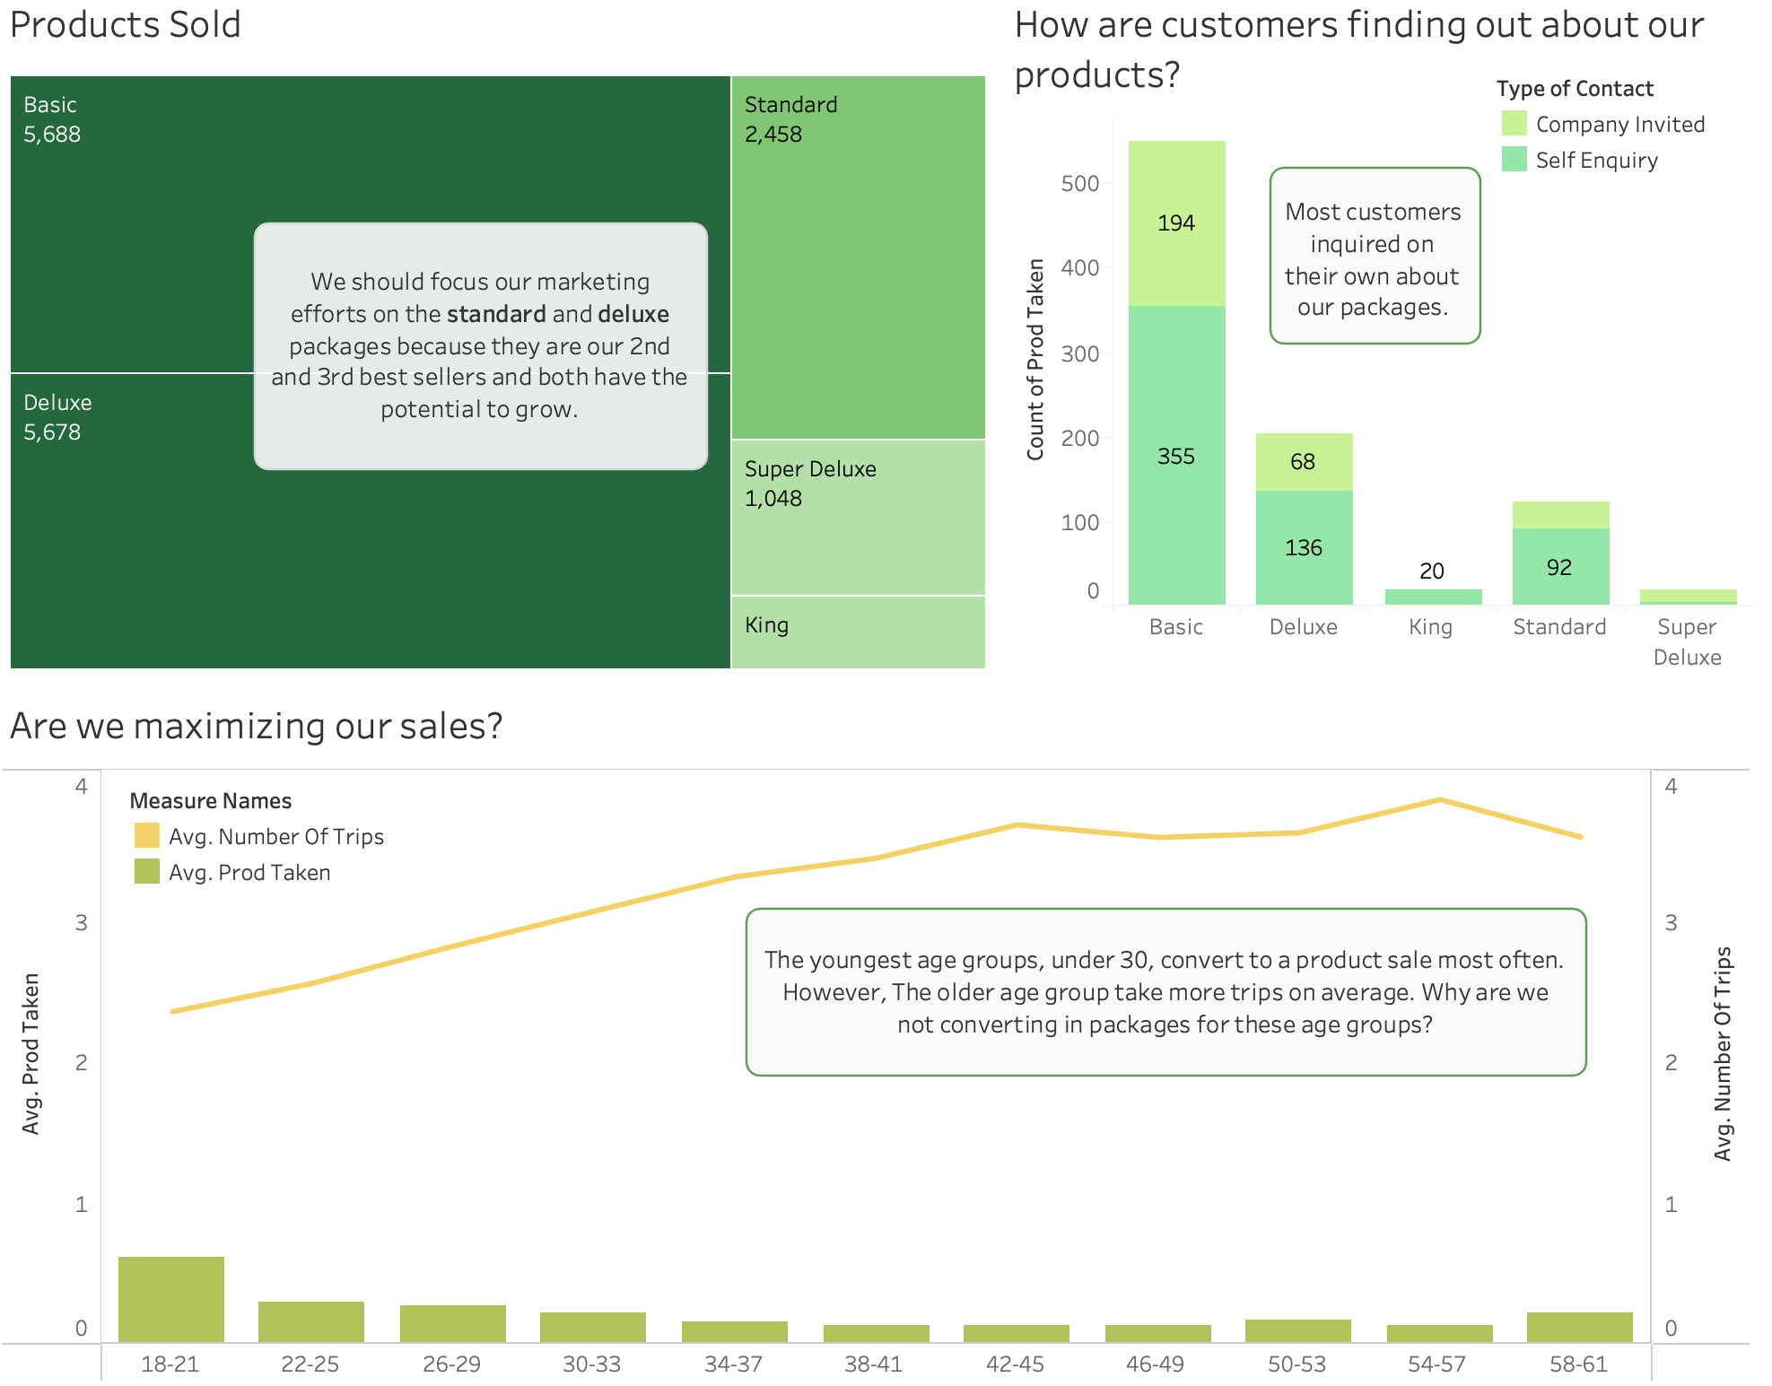
Overall Customer Base
Notes:
Fit entire view, get rid of axis

Slide 9
Standard Package Insights

Slide 10
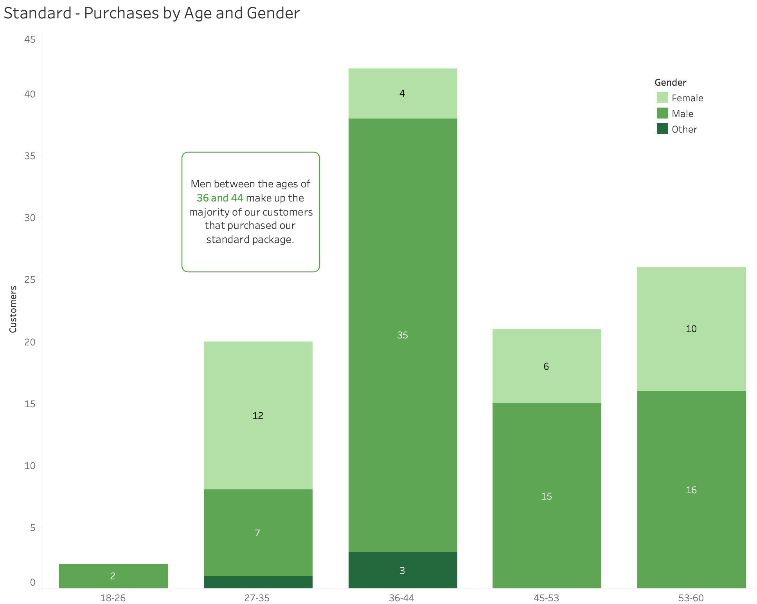
Standard: Customer Age and Gender

Slide 11
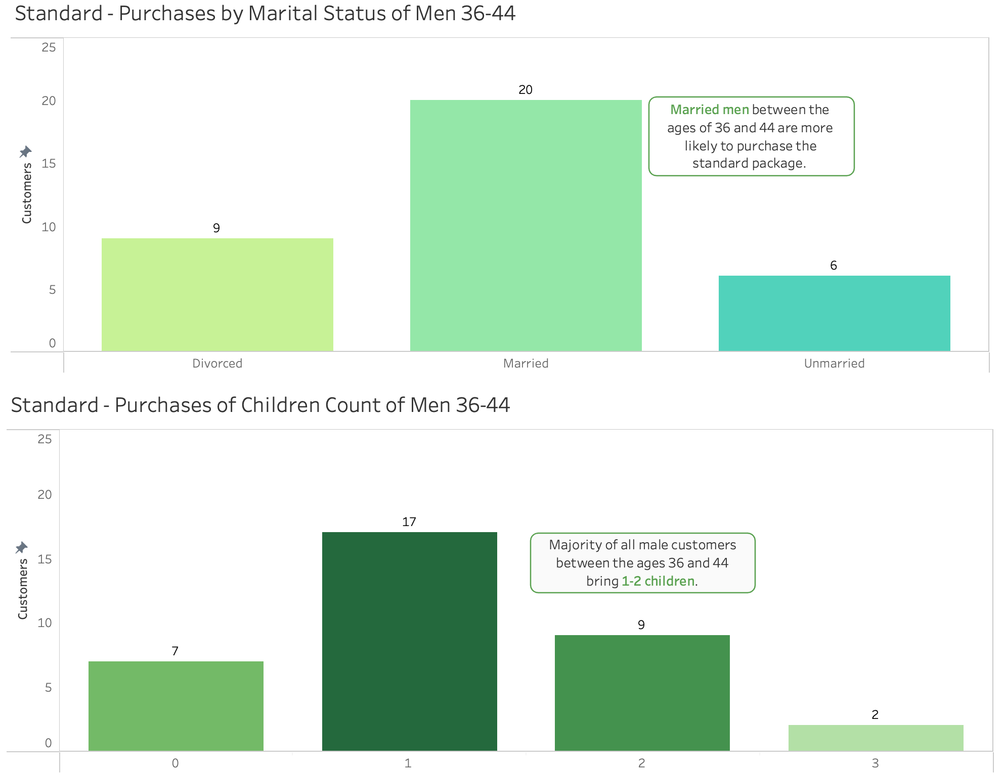

Standard: Customer Family Status

Slide 12
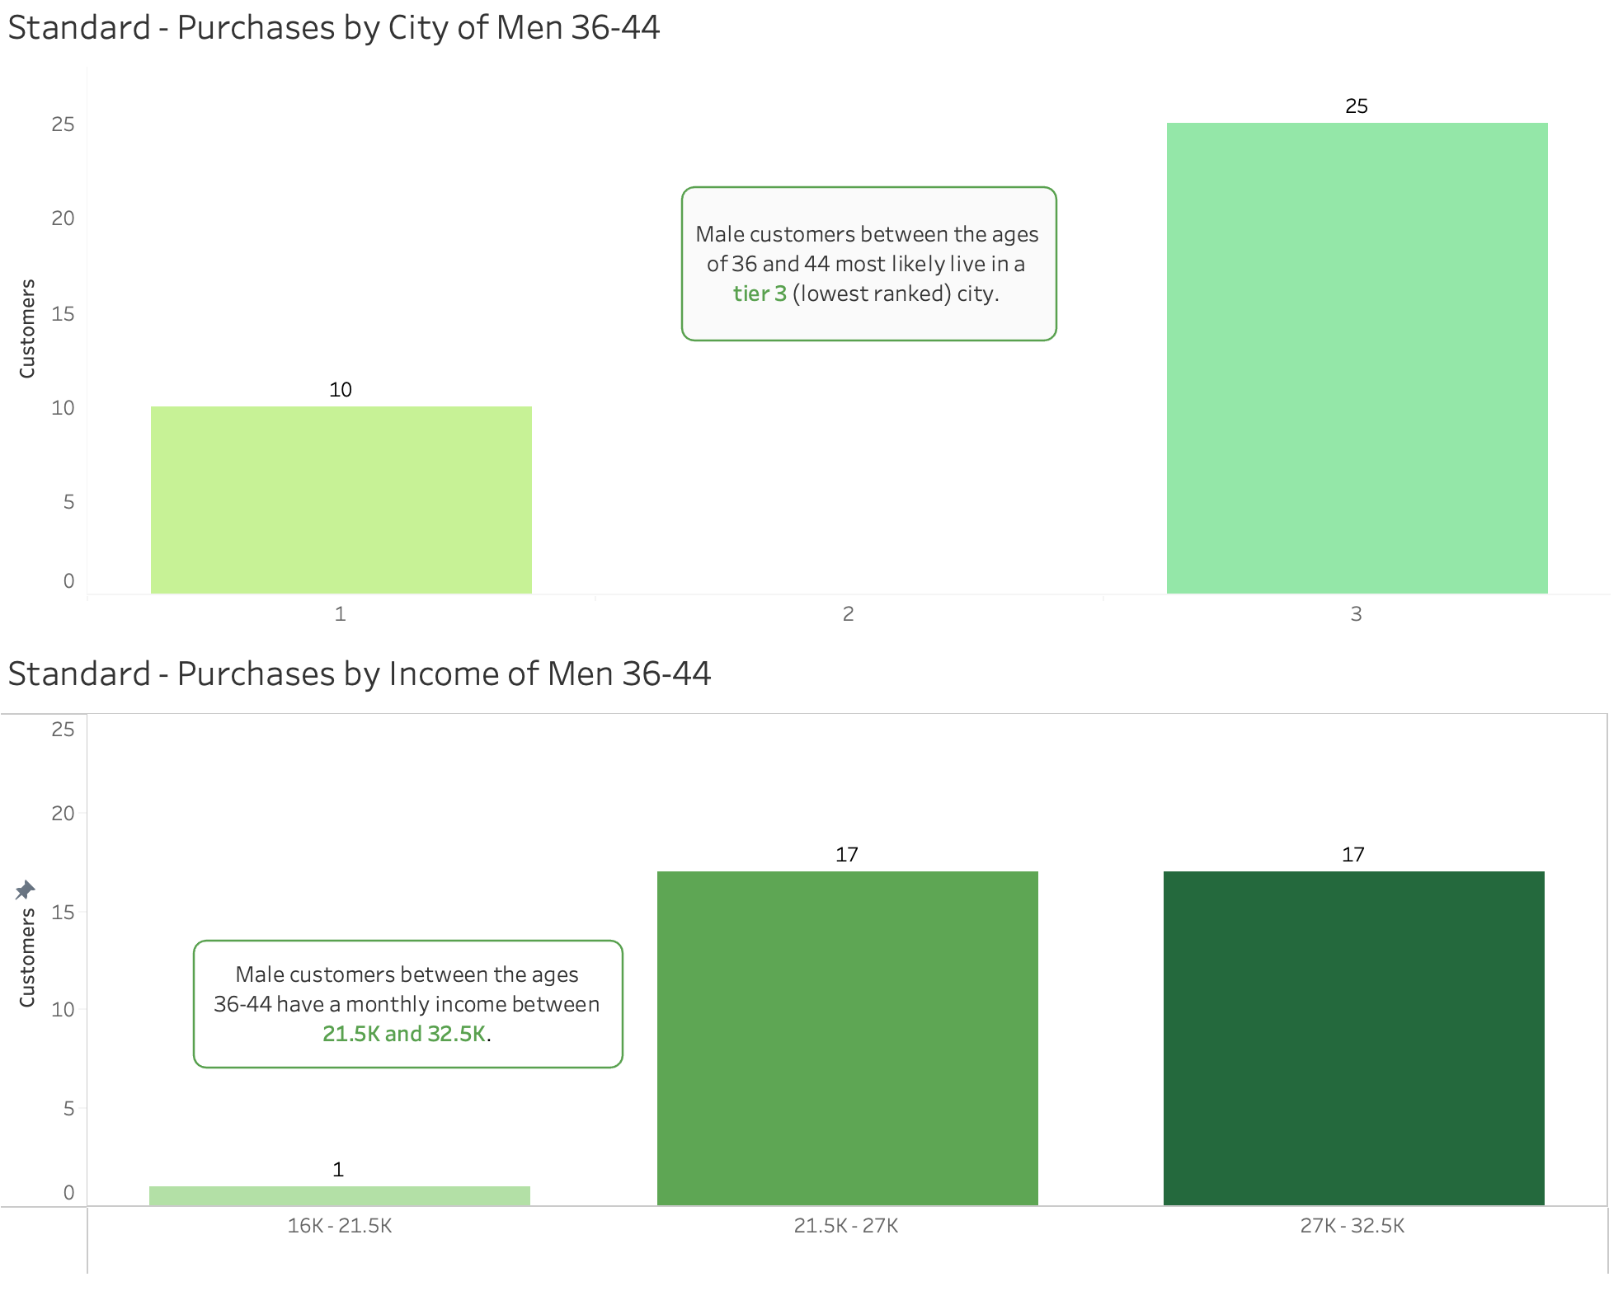
Standard: Customer Income and Living

Slide 13
Customer Profile: Standard Package
Gender: Male
Age: 36-44 years old
# of Children: 1-2
Monthly Income: $21.5k-$32.5k

Slide 14

How to Position the Standard Package
Targeted Ad Highlights:
Family-Friendly Activities
Relaxation and Wellness
Flexible Itinerary Options
Clear Pricing and Inclusions
Example:
“Balance work and family time with our curated travel package! Unlock unforgettable moments for your family in your desired destination.”

Slide 15
Deluxe Package Insights

Slide 16
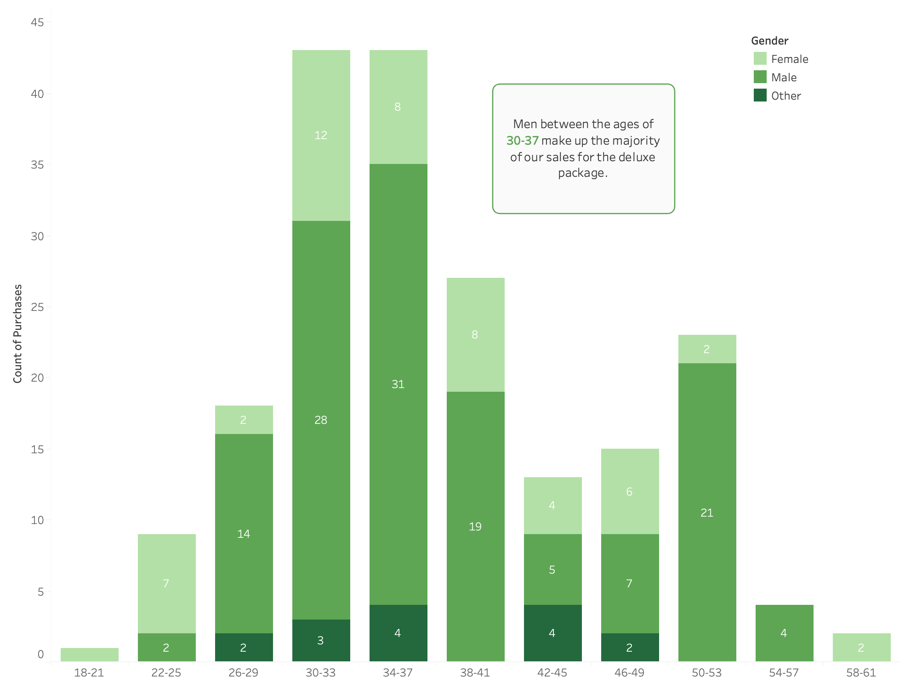
Deluxe: Customer Age and Gender

Slide 17
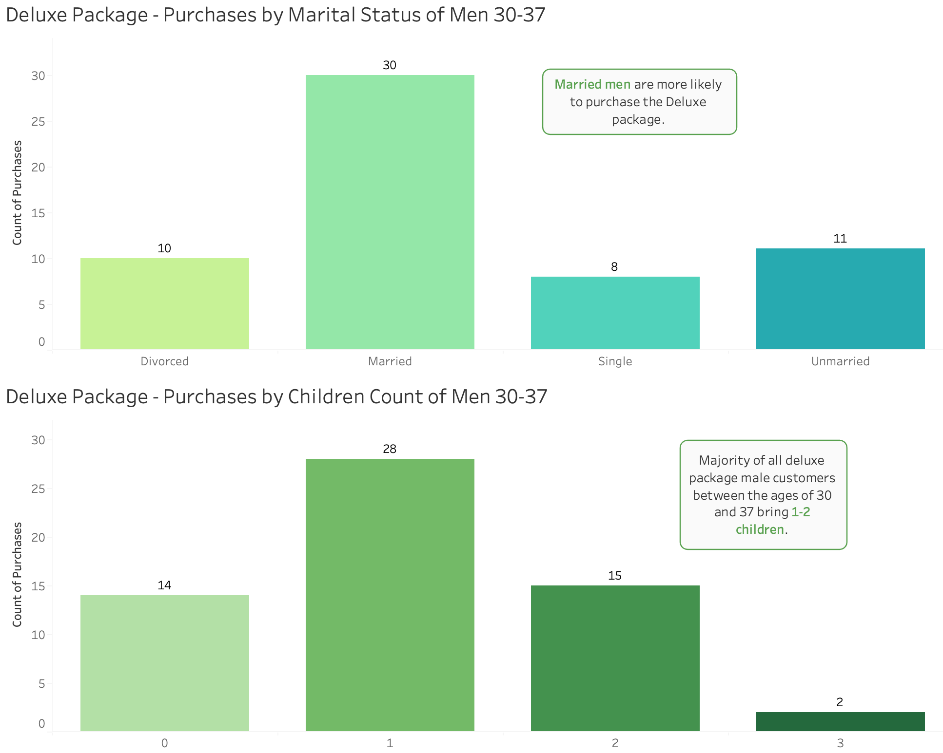
Deluxe: Customer Family Status

Slide 18
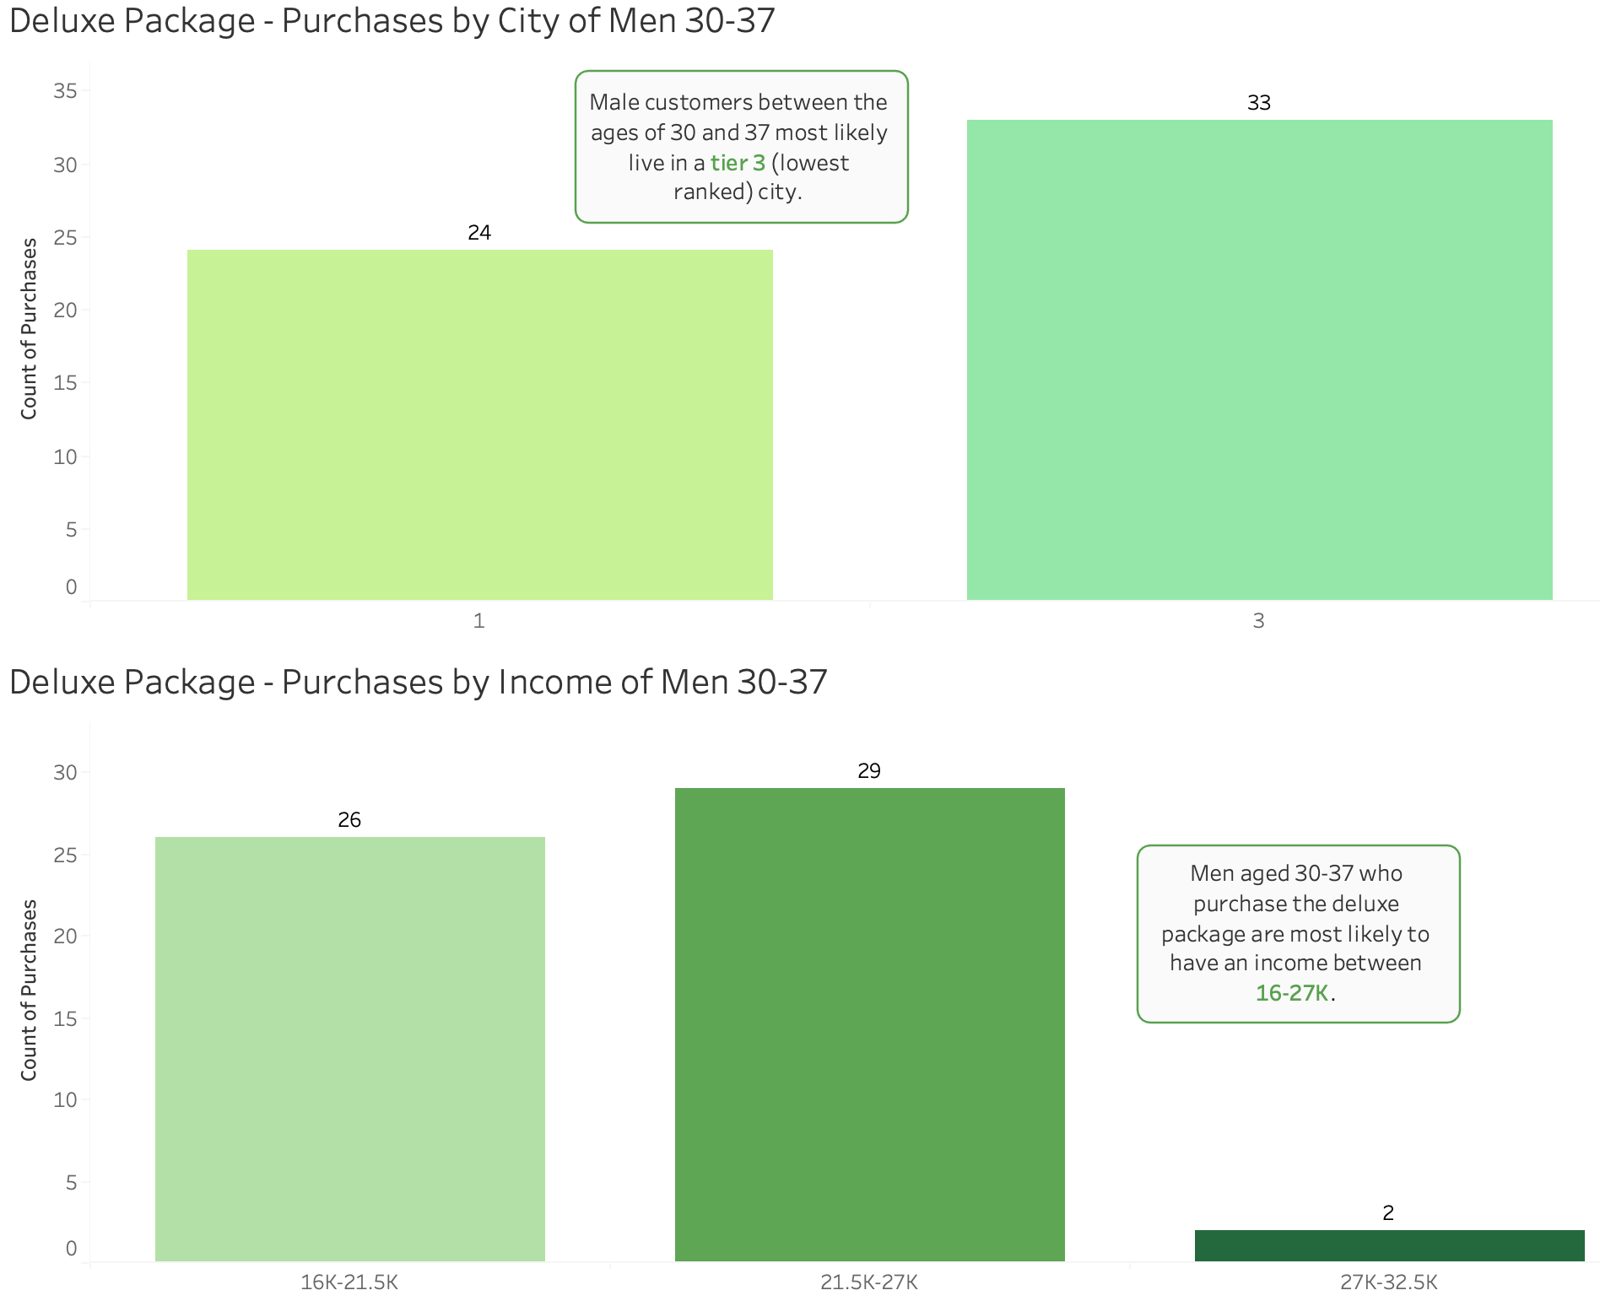
Deluxe: Customer Income and Living

Slide 19
Customer Profile: Deluxe Package
Gender: Male
Age: 30-37 years old
# of Children: 1-2
Monthly Income: $16k-$27k

Slide 20

How to Position the Deluxe Package
Targeted Ad Highlights:
High-value vacation
Family Bonding
Activities and Resources for Younger Children
Exotic and Beautiful destinations
Example:
Luxury family vacation at an affordable price - “treat your family to a getaway”.
Notes:
Since its mostly men with families and the package is more expensive while the income bracket is lower, customers most likely choose this if they are wanting to treat their family, potentially for a special occasion. Marketing effort should focus on perks of this package to encourage families to choose it, showing the value that their money would get them.

Slide 21
What’s next?
Based on the data we have concluded that…
Standard: Married men, ages between 36-44, income $21.5-32.5k, 1-2 children
Deluxe: Married men, ages between 30-37, income $16-27k, 1-2 children
Focus on these customer profiles by promoting family friendly, value packed marketing materials.

